Slide 1
Lesson objective
HOMEWORK OUT!
Title: Parallel and transversal lines
Aim:
Be able to identify angles formed by parallel and transversal lines.
Plan:
Daily review
Introduction video
Notes
Practice
You will need whiteboards, calculators and textbooks.

Slide 2
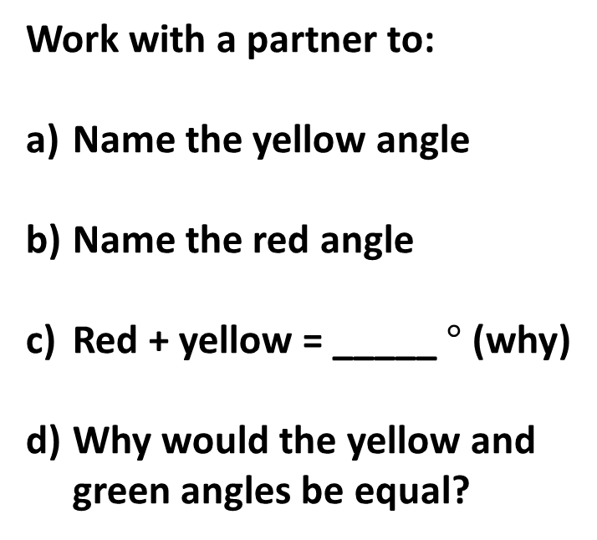



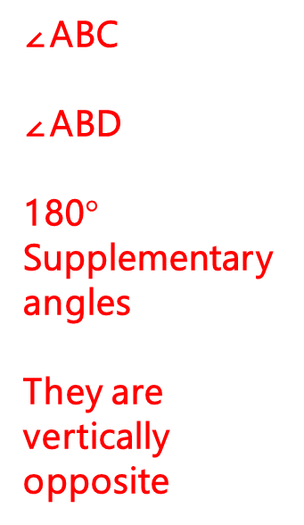
Daily review
45 seconds.
Work with a partner to:
Name the yellow angle
Name the red angle
Red + yellow = _____ $°$ (why)
Why would the yellow and green angles be equal?
A
∠ABC
∠ABD
180$°$ Supplementary angles
They are vertically opposite
D
C
B
E

Slide 3
Introduction video
Goal: remember the 3 types of angles discussed in the video
https://www.youtube.com/watch?v=6RMN5Pf1fHU

Slide 4
Terminology
Think, pair, share.
What were the 3 types of angles presented?
Alternate interior angles
Corresponding angles
Consecutive interior angles
However, we use/say:
Alternate angles
Corresponding angles
Co-interior angles

Slide 5







Notes for folder
Transversal line
Angles 1 and 2 are Supplementary
Angles 2 and 3 are Vertically opposite
Angles 1 and 5 are Corresponding
Angles 2 and 6 are Corresponding
Angles 3 and 6 are Alternate angles
Angles 4 and 5 are Alternate angles
Angles 4 and 6 are Co-interior angles
Angles 3 and 5 are Co-interior angles
Alternate angles are Equal
Corresponding angles are Equal
Parallel lines
1
2
3
4
5
6
7
8
Colour code each angle that is equal. Hint: you only need 2 colours.

Slide 6
Notes for folder
___________ line
Angles 1 and 2 are Supplementary
Angles 2 and 3 are Vertically opposite
Angles 1 and 5 are Corresponding
Angles 2 and 6 are Corresponding
Angles 3 and 6 are Alternate angles
Angles 4 and 5 are Alternate angles
Angles 4 and 6 are Co-interior angles
Angles 3 and 5 are Co-interior angles
Alternate angles are Equal
Corresponding angles are Equal
_________ lines
1
2
3
4
5
6
7
8
Colour code each angle that is equal. Hint: you only need 2 colours.

Slide 7
Whiteboards ready
You will want to have your notes in front of you as well.

Slide 8
125º
a
b
d
c
Which angle is corresponding to 125º.

Slide 9
Which angle is corresponding to 32°.
32°
a
d
b
c

Slide 10
130º
a
b
d
c
Which angle is alternate to 130º.

Slide 11
Which angle is alternate to 60º.
a
b
d
c
60º

Slide 12
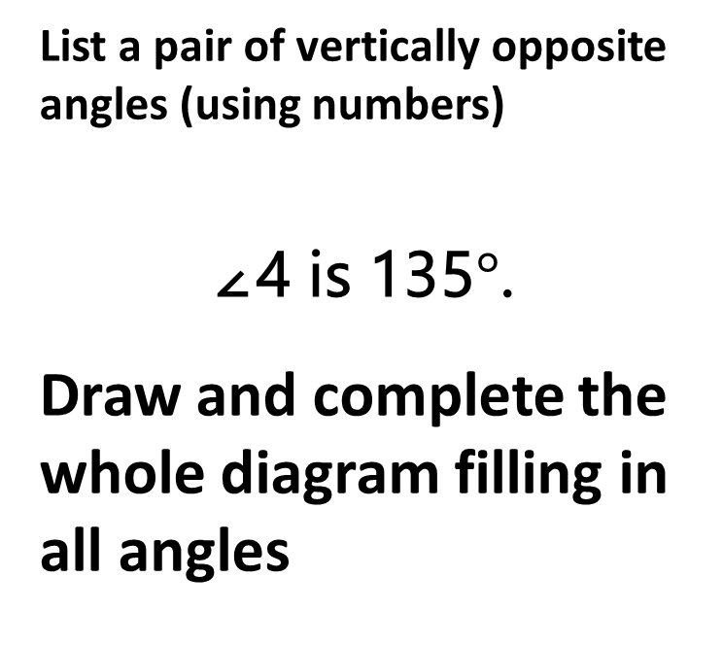
Whiteboards
2 minutes
List a pair of vertically opposite angles (using numbers)
∠4 is 135$°$.
Draw and complete the whole diagram filling in all angles
1
2
3
4
5
6
7
8

Slide 13
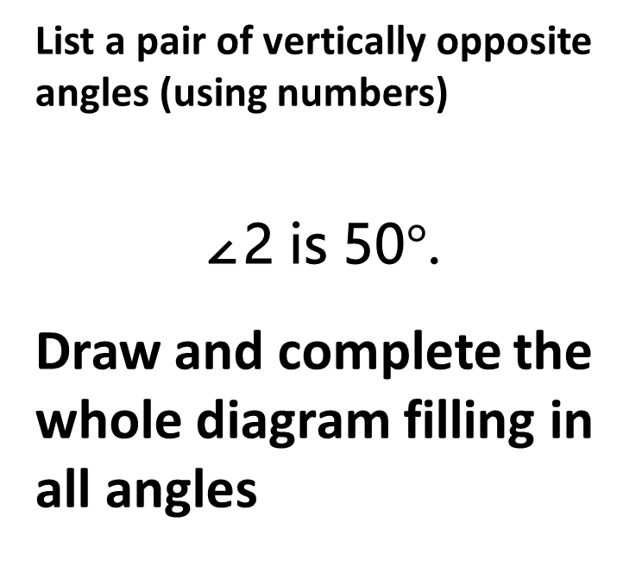
Whiteboards
2 minutes
List a pair of vertically opposite angles (using numbers)
∠2 is 50$°$.
Draw and complete the whole diagram filling in all angles
1
2
3
4
5
6
7
8

Slide 14
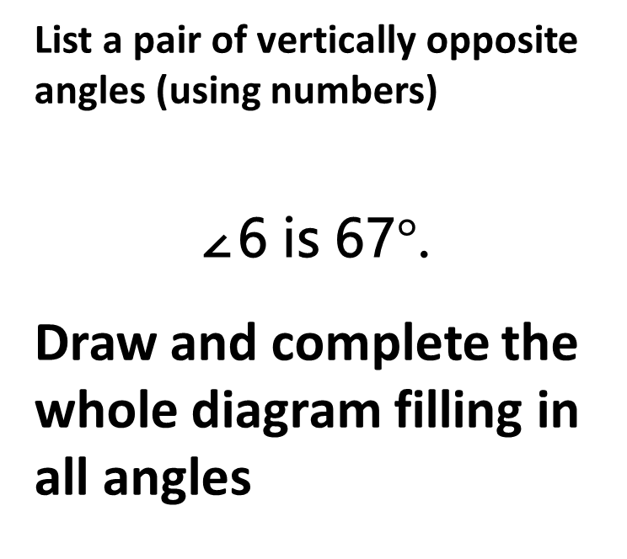
Whiteboards
2 minutes
List a pair of vertically opposite angles (using numbers)
∠6 is 67$°$.
Draw and complete the whole diagram filling in all angles
1
2
3
4
5
6
7
8

Slide 15
Individual practice
Textbook
Page 60
Questions 4 – 12

